Slide 1
Title:
Ethernet Verification IP Development
M. Omais
M. Ahtisham Sudheer
28/08/2025
Notes:
This project focuses on creating a robust and flexible verification environment to ensure the correctness of our high-speed Ethernet designs.

Slide 2
Ethernet/IP in the OSI Model: Layer-wise Overview
Networking systems follow the OSI model. Its a 7-layer framework that standardizes how data moves from one device to another.
OSI Layer | Layer Name | Ethernet/IP Implementation
7 | Application | Device Profile
6 | Presentation | Explicit/Implicit Message
5 | Session | Connection Management
4 | Transport | UDP
3 | Network | IP
2 | Data Link | Ethernet MAC
1 | Physical | Ethernet Physical
Notes:
"To understand our approach, it's essential to start with the foundation: the OSI model. This 7-layer framework is the standard for how data is communicated across any network."
"Our work with Ethernet and IP protocols touches 2 layer to 4 layer of this model. As you can see here:"
"At the Physical and Data Link layers, we have the Ethernet PHY and MAC, handling the raw electrical signals and the basic framing of data packets."
"The Network layer is where IP, or Internet Protocol, operates, responsible for addressing and routing."
"Moving up, the Transport layer often uses UDP for connectionless, high-speed data transfer, which is common in many of our applications."
"And finally, the higher layers are represented by protocols like those defined in EtherNet/IP for industrial automation, handling things like explicit messaging and connection management."

Slide 3
25G Ethernet with Alex Forencich’s Verilog Library
Transmit Sequence
Packet Generation
Create Ethernet /IP /UDP /ARP packets
TX IP/UDP/ARP Handling
Inserts IP/UDP headers, ARP resolution if required.
Computes checksums and validates payload length.
TX MAC Layer
Adds Ethernet headers (Dest/MAC, Src/MAC, EtherType).
Handles flow control, CRC generation, and frame encapsulation.
TX PHY (PCS/PMA)
Serializes frames and sends over 25G link.
Receive Sequence
RX PHY (PCS/PMA)
Deserializes incoming 25G data.
Performs clock and data recovery.
RX MAC Layer
Checks CRC, extracts Ethernet headers, handles flow control.
RX IP/UDP/ARP Handling
Parses IP/UDP headers, verifies checksums.
Resolves ARP requests/replies if present.
Packet Forwarding
Provides structured packet to testbench, Scapy, or application logic.
Notes:
What to Say: "Now, let's look at how this theory translates into the actual hardware data path for a high-speed interface like 25G Ethernet. We've built this using Alex Forencich's excellent open-source Verilog libraries."
"On the Transmit side:"
"It all starts with Packet Generation, where a testbench or a Python script using Scapy creates the raw data we want to send."
"This data is passed to the TX MAC Layer, which encapsulates it. It adds the Ethernet headers—destination and source MAC addresses, the EtherType—and also handles critical functions like flow control and generating the CRC checksum."
"The IP/UDP/ARP Handling block then inserts the appropriate network and transport layer headers, performing tasks like ARP resolution to find MAC addresses and computing IP checksums."
"Finally, the TX PHY takes this structured frame, serializes it, and drives it out onto the physical 100G link."
"On the Receive side, the process is reversed:"
"The RX PHY receives the serial bitstream, recovers the clock and data, and deserializes it back into a parallel data word."
"The RX MAC checks the frame's integrity by verifying the CRC, strips off the Ethernet headers, and manages flow control."
"The IP/UDP/ARP Handling logic now parses the inner packets, verifying checksums and processing any ARP messages."
"And finally, the extracted payload is forwarded up to the testbench or application for verification."
"This diagram gives you a complete picture of the data flow we are responsible for verifying."

Slide 4
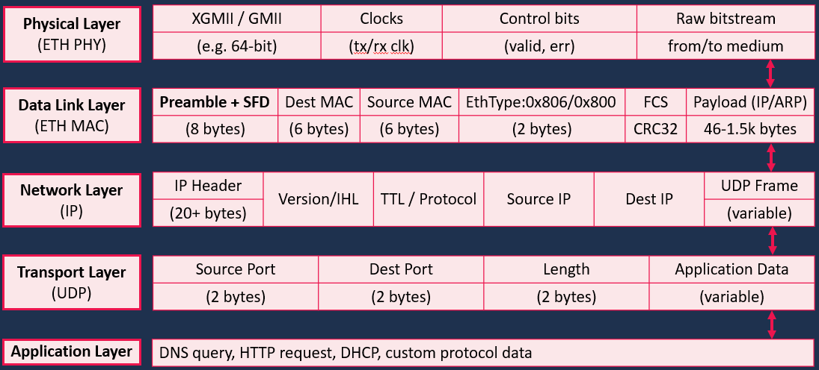
Data Flow Across Network Layers
Notes:
What to Say: "Let's zoom in even further on a single packet to see exactly what bits and bytes we're dealing with. This slide breaks down the encapsulation process, showing the header added at each layer of the protocol stack."
"You can think of this as the anatomy of a typical UDP-over-IP-over-Ethernet packet."
"The Ethernet Frame, built by the MAC, starts with a preamble for synchronization and the Start Frame Delimiter. Then comes the all-important Destination and Source MAC addresses, followed by the EtherType field which tells the receiver what's inside—for example, 0x800 for IP. The frame ends with a CRC for error checking."
"Inside that Ethernet frame is the IP Packet. Its header contains version information, Time-To-Live to prevent loops, the protocol type—17 for UDP—and the source and destination IP addresses."
"Inside that, we have the UDP Datagram. It's a very simple header with just source and destination port numbers, the length, and its own checksum."
"And finally, the payload is the actual Application Data, which could be anything from a DNS query to custom sensor data."
"Understanding this structure is fundamental because our verification IP must be able to construct and deconstruct these packets with 100% accuracy."

Slide 5
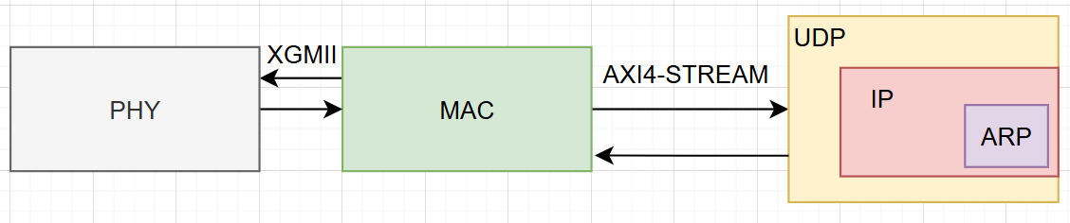
Interfaces Involved
Feature | XGMII (10/25/40G Ethernet) | AXI4-Stream
Purpose | Standard MAC ↔ PHY interface for high-speed Ethernet | Generic high-performance streaming interface for packet/data processing
Data Path | 64-bit (TXD/RXD[63:0]) fixed | Configurable width (8–512 bits)
Control Signals | 8-bit (TXC/RXC) – 1 per byte (data/control distinction) | TVALID, TREADY, TLAST, TKEEP/TSTRB, TID/TDEST/TUSER (rich metadata support)
Framing | Control bits mark start, end, idle, and error | TLAST marks end of packet; TKEEP/TSTRB indicate valid bytes
Flow Control | Supports pause frames, IFG insertion | Flow controlled via TVALID/TREADY handshake
Domain of Use | Ethernet MAC ↔ PHY physical interface | Packet processing, DMA engines, NoCs, FPGA IP integration
Standardization | IEEE 802.3 (Ethernet specific) | ARM AMBA AXI4 standard (generic, protocol-agnostic)
Notes:
What to Say: "To move this data between the different hardware blocks—like between the MAC and the PHY—we use standard interfaces. This slide compares the two key interfaces involved in our design."
"First, XGMII and its variants:"
"This is the standardized IEEE-defined interface that connects the Ethernet MAC to the Physical layer. It's very purpose-built for Ethernet."
"It has a fixed 64-bit data path and uses separate control bits to distinguish between data bytes and control characters that indicate idle periods or start/end of frame."
"Its flow control is handled through Ethernet-specific pause frames."
"Second, AXI4-Stream:"
"This is a generic, high-performance streaming interface from the ARM AMBA family. We use it extensively elsewhere in our FPGA designs for packet processing and DMA transfers."
"It's much more flexible and configurable than XGMII. The data width can be tuned, and it has a rich set of signals like TREADY/TVALID for hardware flow control and TLAST to mark the end of a packet."
"It's protocol-agnostic, meaning it can carry Ethernet packets, PCIe packets, or just raw data."
"Why does this matter for verification?"
"Our VIP needs to interface with both. It must understand the specifics of XGMII to interact with the PHY layer correctly, while also being able to handle packets on an AXI4-Stream bus for higher-level processing and checking. This dual-interface support is a key feature of our VIP's architecture."

Slide 6
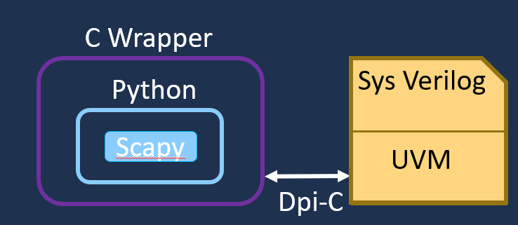
Scapy Integration for UVM-Based Eth IP Verification
Scapy: A Python library for generating, parsing & analyzing network packets (Ethernet, IP, UDP, ARP, etc.), with built-in support for checksums, fuzzing, and automated protocol testing.
C Wrapper: A lightweight C layer built using the Python/C API, acting as a translator between Python and SV. It invokes Scapy functions, manages data type conversions, and exposes packet data to the simulator.
DPI-C: A standardized interface that enables direct communication between SystemVerilog and C. It allows importing C functions into the HDL environment.
SystemVerilog/UVM: The main verification environment, responsible for stimulus generation, monitoring, scoreboard checking, and functional coverage. It integrates with DPI-C to use Scapy for packet-level testing of Ethernet/IP/UDP stacks.
Notes:
Next, I’ll walk you through how we integrated Scapy, into a UVM-based Ethernet IP verification flow:
We begin with Scapy, a Python library that generates and analyzes packets—like Ethernet, IP, and UDP. It supports checksums, fuzzing, and protocol testing, making it ideal for packet-level verification.
To connect Scapy to our testbench, we use a C wrapper—a lightweight layer built with the Python/C API. It translates between Python and SystemVerilog by invoking Scapy functions, converting data types, and passing packets to the simulator.
This C wrapper is linked to SystemVerilog using DPI-C, a standard interface that allows direct communication between C and the HDL environment.
On the testbench side, we have SystemVerilog with UVM. UVM handles stimulus generation, checking, and coverage. Through DPI-C, it connects with Scapy to enable real packet-level testing of Ethernet/IP/UDP stacks.
-----------------------------------------------------------------------------------------------------------------------------------------
“Looking at the diagram on the right:
We see Scapy inside a Python environment,
Wrapped with a C layer
Connected via DPI-C to our SystemVerilog + UVM testbench.

Slide 7
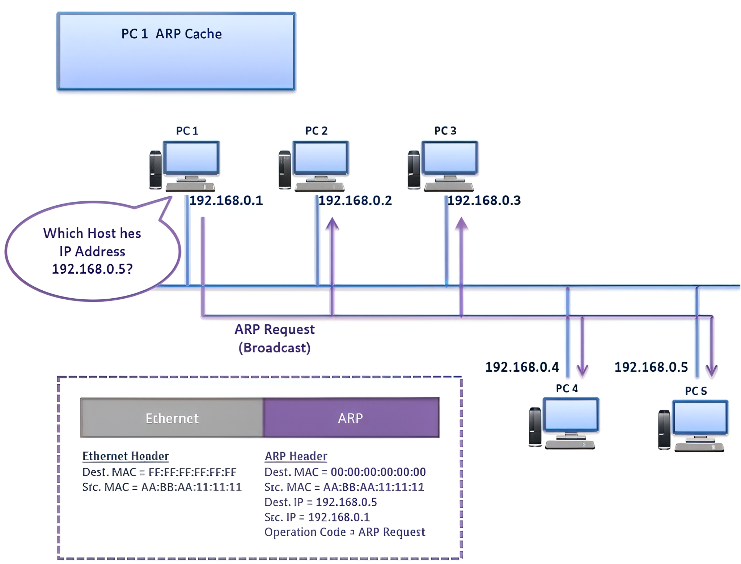
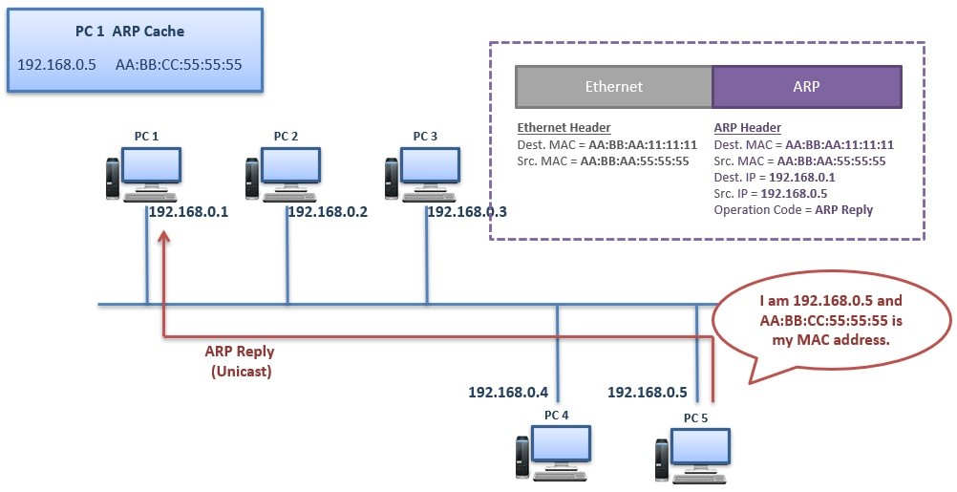
ARP (Address Resolution Protocol)
ARP is a Layer 2 network protocol. Layer 2 uses MAC addresses and Layer 3 uses IP Addresses for the communication. ARP Protocol is used to discover the MAC Address assosiated with a known IPv4 Address .
For IP packet transfer, the source needs to know the destination MAC address. If unknown, the source floods the network, sending packets to all devices, causing unnecessary traffic. When the MAC address is known, the source can send the packet directly to the destination.
Example:
Notes:
“Now let’s briefly look at ARP, or Address Resolution Protocol.
ARP is a Layer 2 protocol used to discover the MAC address associated with a known IPv4 address.
For IP packet transfer, the source needs to know the destination MAC address. If unknown, the source floods the network, sending packets to all the devices, causing unnecessary traffic. When the MAC address is known, the source can send the packet directly to the destination avoiding unnecessary traffic flows.
For Example: If a device—say PC1—wants to send data to another device but doesn’t have its MAC address in the ARP cache, it broadcasts an ARP request saying: “Who has got this IP address?”
The device with the matching IP replies with its MAC address. PC1 then stores this in its cache to avoid repeating the request in future communications.”

Slide 8
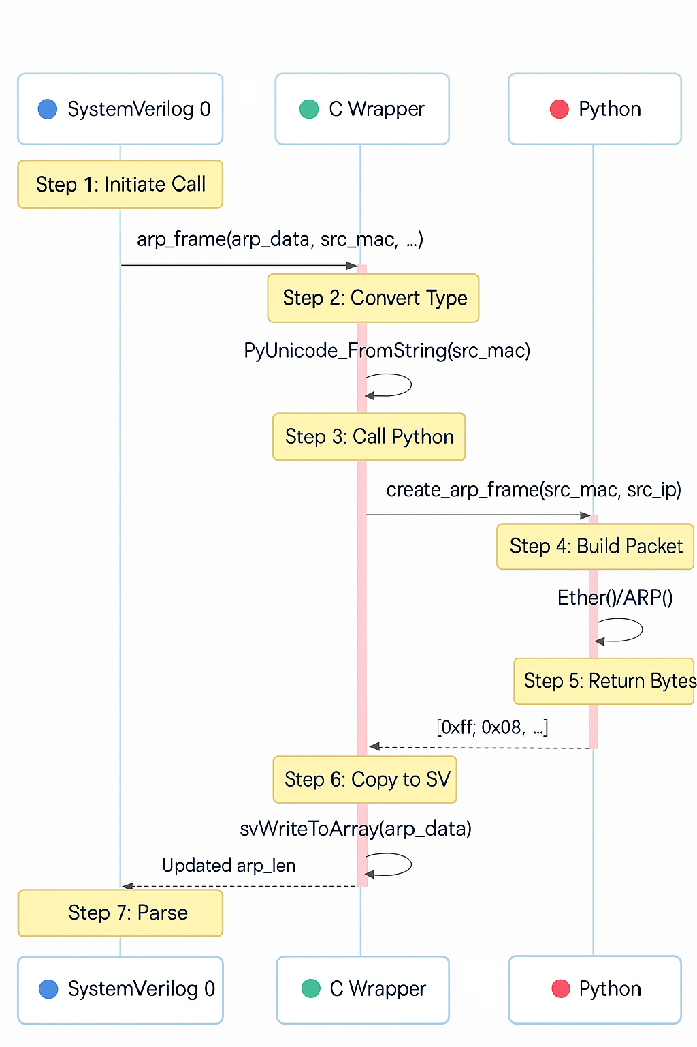
ARP Frame Creation and Parsing Flow
SystemVerilog initiates the ARP frame creation by calling a arp function and providing the required data, such as source MAC, destination MAC, and IP addresses.
The C Wrapper processes the input data, converting SystemVerilog types into Python compatible formats so that Python can use them correctly.
Python constructs the ARP frame using the input data, creating the Ethernet and ARP headers and assembling the complete packet using Scapy
The C Wrapper returns the generated frame by copying the raw bytes back into SystemVerilog memory.
SystemVerilog parses the returned ARP frame, extracting and verifying fields to ensure the frame is correctly formed.
Notes:
“This slide shows the flow of ARP frame creation and parsing across SystemVerilog, C Wrapper, and Python.
1. The process starts in SystemVerilog, which initiates the ARP frame creation by calling a function with inputs like source, destination MAC and IP addresses. 2. The C Wrapper then converts these SystemVerilog types into Python-compatible formats - like arrays to lists.
3.Python uses this data to build the ARP frame, assembling the Ethernet and ARP headers using Scapy. 4.Once created, the C Wrapper copies the raw frame bytes back into SystemVerilog memory. 5.Finally, SystemVerilog parses the returned ARP frame, verifying that it is correctly formed before further use.
This seamless flow ensures that packet creation and validation integrate the strengths of each language and environment.”

Slide 9
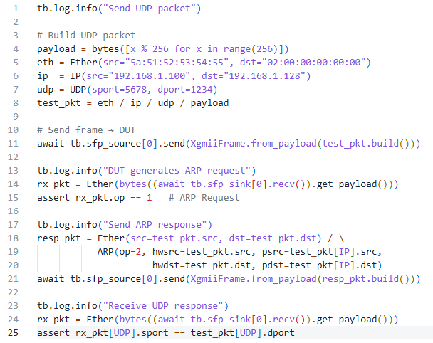
Test Case of UDP
Building UDP Packet
Test bench send UDP packet to DUT
ARP Request from DUT
ARP Reply from TB module
Checking expected UDP
response
Notes:
We build SV based test cases for each networking layer and this slide shows a sample UDP test case where it build, send, and verify UDP packets in the testbench using Scapy.
The test creates a UDP packet with specific source and destination addresses and ports.
It sends the packet to the DUT and waits for an ARP request from the DUT.
The testbench responds with an ARP reply to start communication.
Finally, it checks that the DUT correctly receives the UDP response with the expected port values.

Slide 10
🫡
muhammad.omais@arcanasemi.com
ahtisham.sudheer@arcanasemi.com

